Slide 1


Image-to-Image Translation for
Clutter and Subsurface Discrimination
in Radar Sounder Data
Samuele Trainotti
a.a. 2024/2025
Supervisor: Bruzzone Lorenzo
Co-Supervisor: Dal Corso Jordy

Slide 2
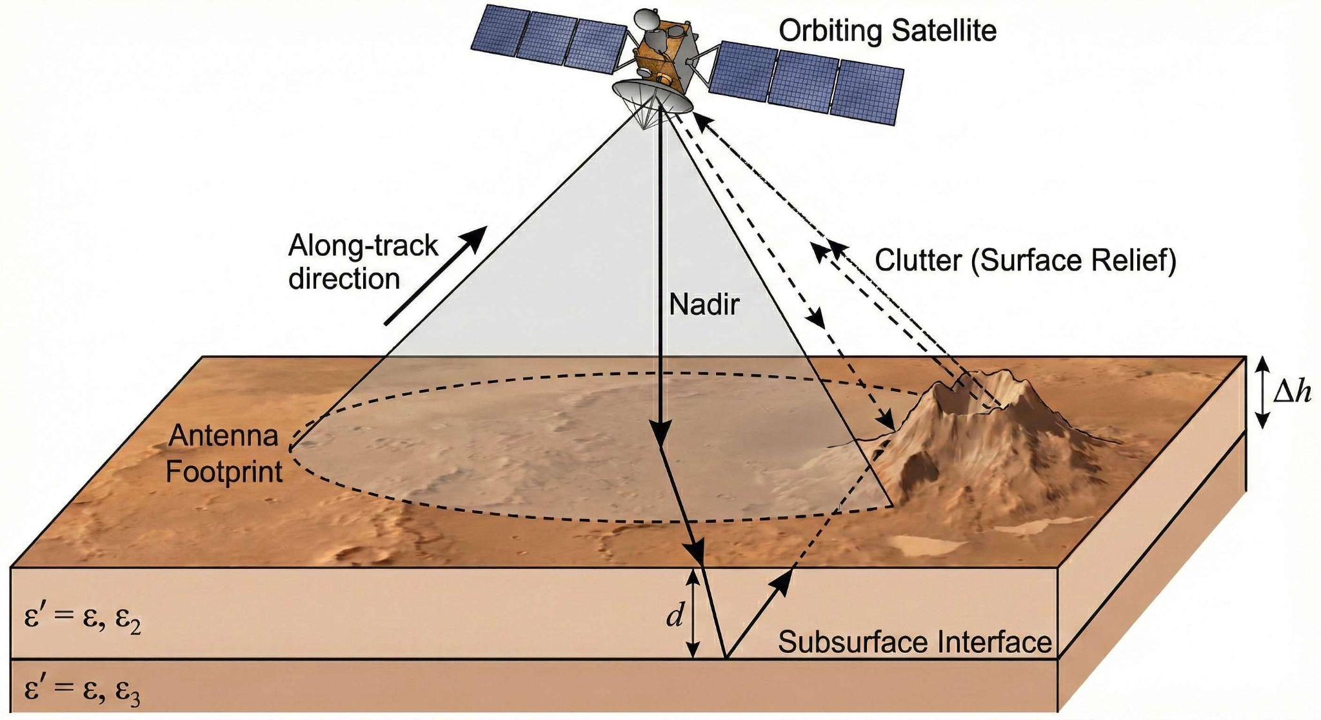
Planetary Exploration & Data Volume
Orbital Radar Sounders: Acquire terabytes of subsurface data to locate Martian ice and geological structures
The Data Bottleneck: The data volume (tens of TBs) vastly exceeds manual interpretation limits
Goal: Develop automated, data-driven analysis pipelines

Slide 3
The Challenge of Surface Clutter
Surface Clutter: Off-nadir topographical reflections mimic true underground structures
The Domain Gap: Simulators predict clutter but lack noise, speckle, and attenuation
The Machine Learning Barrier: No labeled ground truth on Mars for supervised learning

Slide 4
Unsupervised Anomaly Detection via Sim-to-Real Translation
Approach: Sim-to-Real image translation
Hypothesis: The network learns the "normal" clutter background. Unmodeled subsurface interfaces emerge as anomalies in the residual map

Slide 5
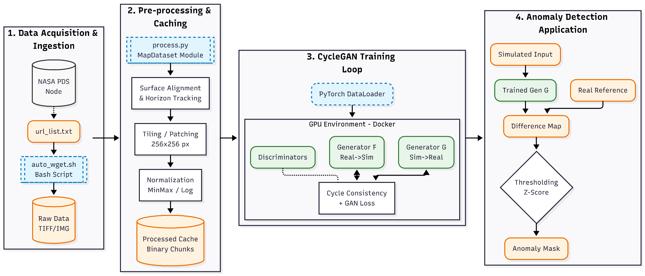
Unsupervised Anomaly Detection via Sim-to-Real Translation

Slide 6
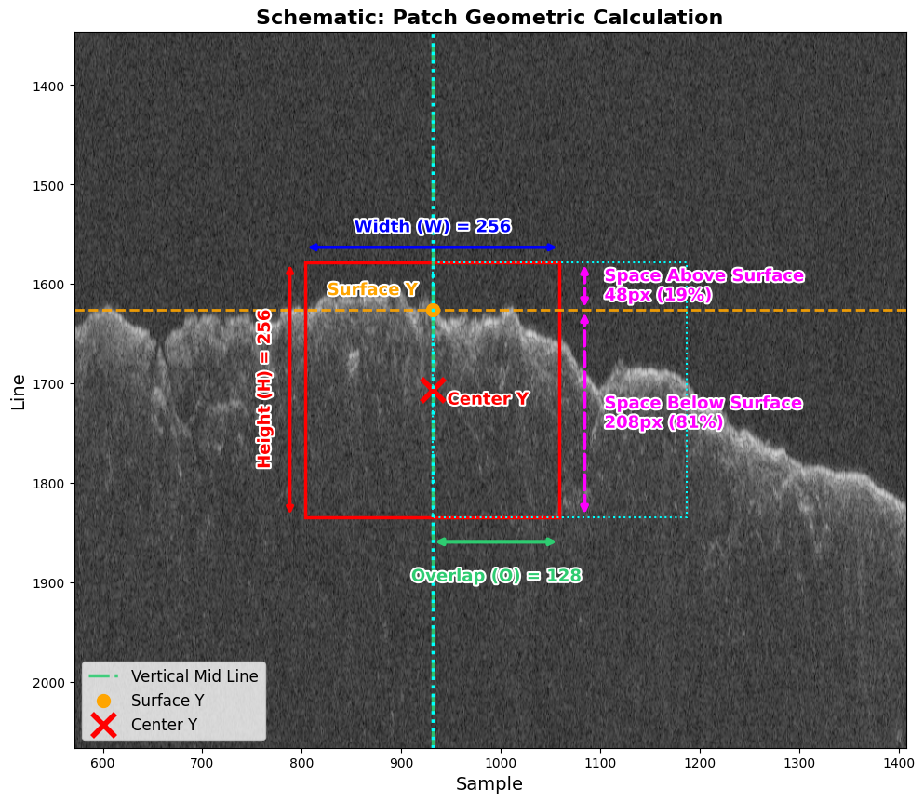
Scalable Data Engineering:
Dynamic Patching
Surface-Aware Extraction: Custom sliding window algorithm that dynamically tracks the Martian topography
Data Optimization: Discards uninformative atmospheric regions, focusing strictly on the subsurface
Fast Inference Tracking: Enables rapid processing of 128x128 patches (~4.2 ms per patch on RTX 3090 GPU)

Slide 7
Scalable Data Engineering: Normalization
Dynamic Range Mitigation: Logarithmic (dB) scaling to compress the energy difference between surface and subsurface
Min-Max Scaling: Applied 1st and 99th percentile clipping to suppress extreme reflections that destabilize GAN gradients
Reproducibility: Fully Dockerized environment & Optuna hyperparameter tuning

Slide 8
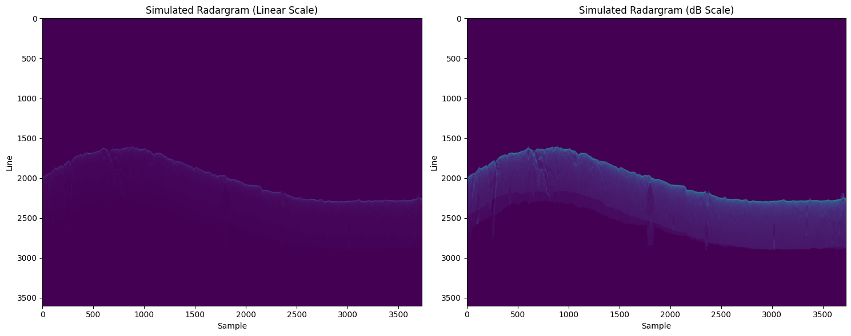
Scalable Data Engineering: Normalization

Slide 9
Bridging the Gap: Unpaired Image Translation
Unpaired Translation: CycleGAN selected over Pix2Pix to relax spatial constraints and overcome unavoidable misalignments between simulator and real data
Cycle-Consistency: Preserves input simulation structure while injecting realistic speckle
Generator (ResNet): Employs Reflection Padding instead of zero-padding to eliminate grid artifacts (edge effects) during patch reconstruction
Discriminator (PatchGAN): Enforces high-frequency texture realism to synthesize accurate speckle noise

Slide 10
Validation Framework: Synthetic Anomaly Injection
The Challenge: No labeled ground truth exists for Martian subsurface anomalies (supervised validation is impossible)
The Solution: Physics-informed Synthetic Anomaly Injection into real radargrams
Physical Constraints: Injected targets follow depth-dependent attenuation and speckle interference laws
Advantage: Provides exact binary masks to compute rigorous ROC and Precision-Recall metrics

Slide 11
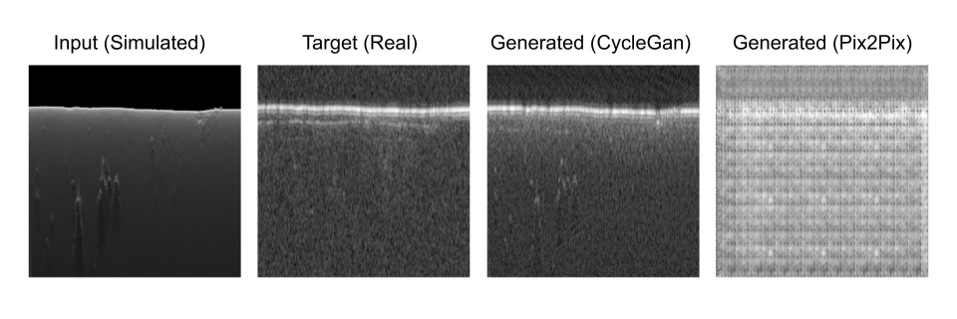
Sim-to-Real Generative Quality
CycleGAN successfully synthesizes realistic speckle and preserves topography
Pix2Pix suffers from structural distortions due to imperfectly aligned data

Slide 12
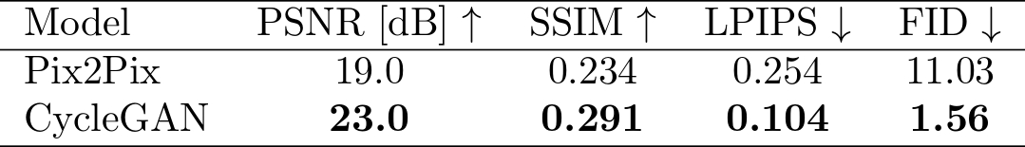
Quantitative Generative Metrics
Fréchet Inception Distance (FID): 1.56 (CycleGAN) vs 11.03 (Pix2Pix). Confirms high statistical realism
LPIPS: 0.104. Validates excellent structural integrity during domain transfer

Slide 13
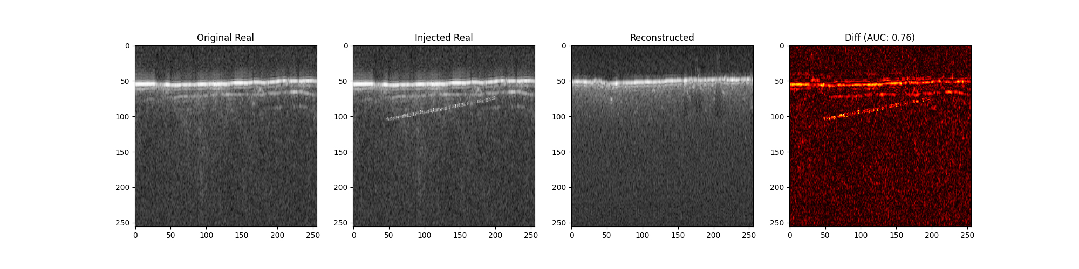
Clutter vs. Subsurface Discrimination
Real: Contains clutter + injected anomaly
Generated: Reconstructs only surface clutter
Residual Map: Successfully isolates the unmodeled subsurface anomaly

Slide 14
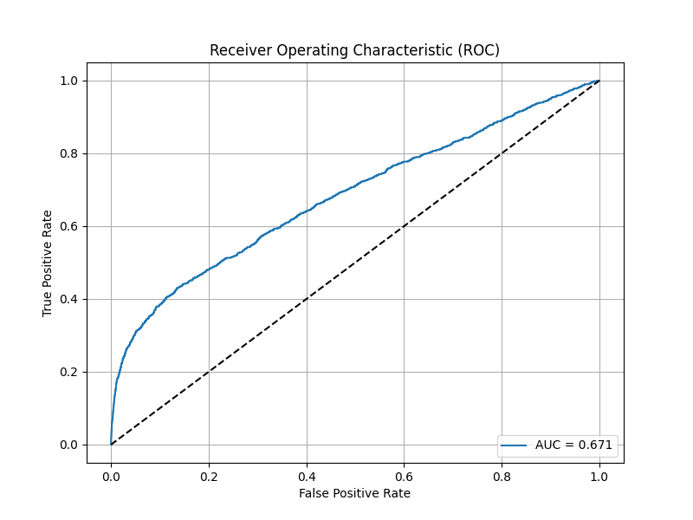
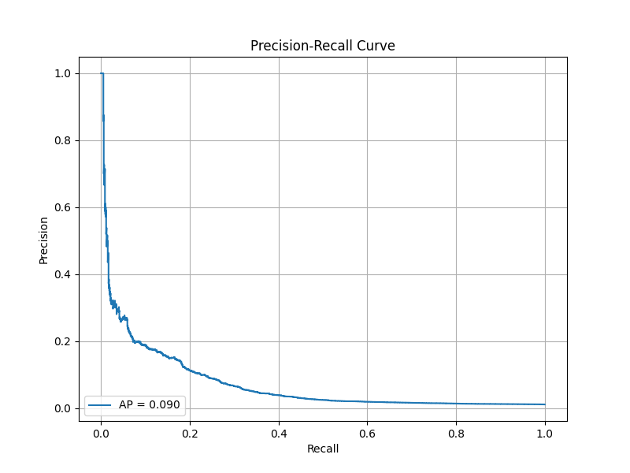
Detection Performance
Evaluated on 60 patches with injected anomalies
ROC AUC = 0.671: Unsupervised discriminative capability
mAP = 0.089: Highlights the inherent difficulty caused by severe speckle noise

Slide 15
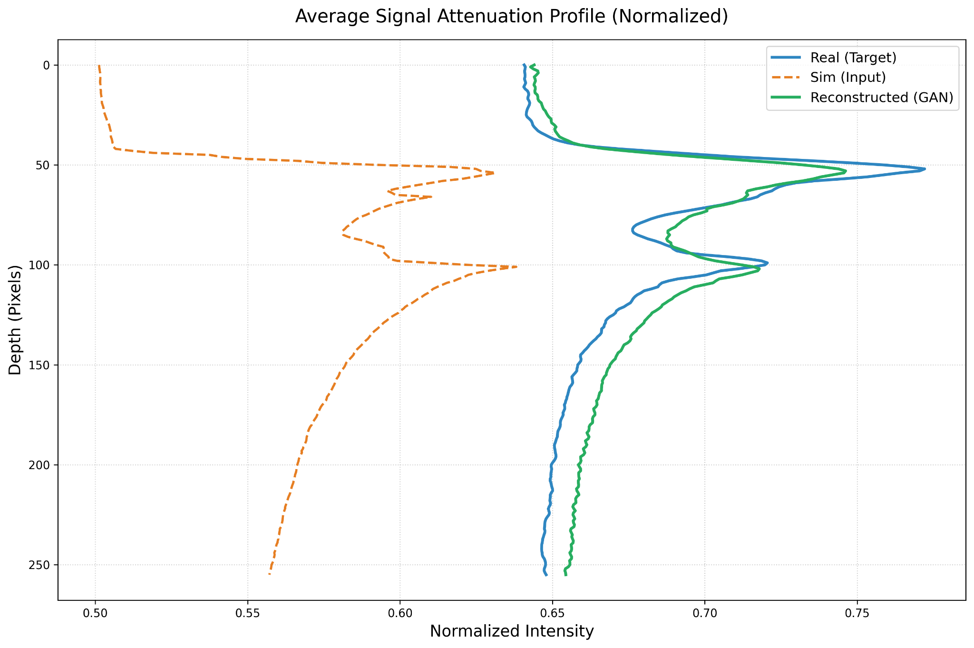
Limitations: Vision Models vs. Physical Laws
Signal Attenuation: GANs replicate local textures but struggle to explicitly learn global exponential energy decay
Engineering Mitigation: Independent Z-score normalization applied before residual computation to remove vertical bias

Slide 16
Conclusions
Developed a scalable, memory-safe data engineering pipeline
Successfully bridged the Sim-to-Real domain gap using CycleGAN.
Validated an unsupervised anomaly detection framework via synthetic injection

Slide 17
Future Works
Physics-Informed loss to explicitly enforce energy decay equations
Adaptive thresholding for residual maps
Validation on verified geological datasets from diverse Martian regions
Extension to future planetary missions (e.g., ESA JUICE, NASA Europa Clipper) to analyze icy moons

Slide 18
Thank you for your attention
Questions?

